Slide 1



System and Organisational Structure
Understanding how health and care services are organised in Derby and Derbyshire
Notes:
The purpose of this slide deck is to provide an overview of how health and care services are organised in Derby and Derbyshire.
The aim of this is to help you understand the structure and how different organisations work together.

Slide 2
The structure in this presentation are subject to change
The NHS is undergoing major changes nationally.
NHS England will be abolished by March 2027, with its functions set to move into the Department of Health and Social Care.
Integrated Care Boards will change how they work and must cut their running cost by 50%.
Healthwatch England and local Healthwatch will close.
Changes will be made to health and social care laws.

Slide 3
Integrated Care Systems (ICS)
JUCD is your local Integrated Care System (ICS) for Derby and Derbyshire.
It is currently one of 42 ICSs across England.
It brings together NHS organisations, local authorities, and the voluntary, community, and social enterprise (VCSE) sector to coordinate health and care services.
JUCD is responsible for coordinating health and social care services across Derby and Derbyshire.
JUCD aims to:
Improve population health and healthcare.
Tackle inequalities in outcomes, experience, and access.
Enhance productivity and value for money.
Support broader social and economic development.
The NHS is undergoing major changes, ICSs like JUCD will remain, but their roles and responsibilities are evolving as part of national reforms.
Joined Up Care Derbyshire
Notes:
JUCD doesn’t raise its own income. Its funding comes primarily through the Derby and Derbyshire ICB which receives allocations from NHS England. JUCD also works with local authorities through pooled budgets such as the Better Care Fund and may access targeted national programmes for priorities like mental health, digital transformation, and reducing health inequalities.

Slide 4
Integrated Care Board (ICB)
Flow of NHS Funding
What is the ICB?
The ICB is the NHS organisation responsible for planning, managing the budget, and allocating resources across Derby and Derbyshire.
It works with partners to improve population health, reduce inequalities, and ensure services are safe and effective.
The ICB oversees delivery across hospitals, GP practices, community services, and more.
The flow of funding is set to change and will come directly from DHSC.
NHS England
Annual Allocation to ICBs
Local Health Services (Hospitals, Community Care, Mental Health and Primary Care)
Derby and Derbyshire Integrated Care Board
Notes:
NHS England allocates budgets based on population size, health needs and deprivation.
Additional streams include Better Care Fund, Targeted programmes, i.e. MH, Digital, etc and continuing health care.
It is the local ICBs responsibility to manage public money to ensure value for money and equitable access.

Slide 5
ICB Cluster Arrangements – NHS Reform
In March 2025, NHS England announced that Integrated Care Boards (ICBs) must reduce their running costs by 50%.
NHS England published proposals for the consolidation and merging of ICBs.
Under these plans, the current 42 ICBs will be grouped into 27 clusters, with formal mergers expected by April 2026.
Clusters may have joint Boards or Committees for shared priorities, but each ICB remains a separate statutory body.
Every ICB retains its own legal responsibilities, accountability for its local population and budget, and decision-making authority under the Health and Care Act 2022.
What does this mean for us locally

Slide 6
Derbyshire, Lincolnshire and Nottinghamshire (DLN)
As part of the national NHS reform and cost reduction programme, the three ICBs (Derbyshire, Lincolnshire and Nottinghamshire) have formed a cluster arrangement.
These will work together (while remaining separate legal entities) to oversee healthcare planning and provision.
The aim is to streamline operations, reduce management costs and focus more on health needs and outcomes.
We now have a cluster Board, with one CEO, Chair and Executive team.
DLN Leadership Team
Notes:
Chair Designate: Dr Kathy McLean OBE Already Chair of Derby and Derbyshire ICB and Nottingham and Nottinghamshire ICB.
Appointment confirmed by the Secretary of State for Health and Care.
Chief Executive Designate: Amanda Sullivan Currently Chief Executive of Nottingham and Nottinghamshire ICB.
Appointed to lead the cluster and deliver on the NHS 10-Year Plan, focusing on prevention, digital transformation, and reducing health inequalities.

Slide 7
Derby and Derbyshire Integrated Care Partnership (ICP) – System Level
What is the ICP?
The Integrated Care Partnership (ICP) is a formal alliance of the NHS, local authorities, and voluntary/community sector partners in Derby and Derbyshire.
Its main role is to develop and oversee the Integrated Care Strategy a plan for improving health and wellbeing across the area.
The ICP sets shared priorities, aligns services, and ensures that decisions reflect the needs of local people.
It is a key forum for collaboration and strategic planning.
Derby and Derbyshire Integrated Care Partnership
Notes:
Derby and Derbyshire's Integrated Care Strategy focuses on improving lifelong health and reducing inequalities for everyone in Dery and Derbyshire. It’s three main priority areas are:
1. Start Well
Improve care and reduce inequalities in health, social, emotional, and physical development for children in the early years (ages 0–5).
Support families and give every child the best start in life.
2. Stay Well
Focus on prevention and early intervention for the main causes of ill health and early death: circulatory disease, respiratory disease, and cancer.
Help people of all ages to maintain good health and wellbeing, and manage long-term conditions effectively.
3. Age Well and Die Well
Enable older people to live healthy, independent lives at home for as long as possible.
Prioritise health and wellbeing in later life, support people in a crisis to remain at home where possible, and maximise a return to independence after illness.
Ensure compassionate, high-quality end-of-life care.

Slide 8
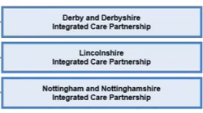
ICPs – NHS Reform
ICPs are a statutory requirement.
As part of the reform, we now have 3 Partnerships that feed into the Cluster ICB Board.
From NHS England Announcements and Government Plans, we know that ICPs may lose statutory status with some responsibilities moving to Health and Wellbeing Boards.

Slide 9
Place Partnerships
What are Place Partnerships?
These partnerships focus on planning and delivering services at the local authority level (Derby City and Derbyshire County).
They bring together health, care, and community organisations to meet local needs.
They are non-statutory, meaning they are not legally mandated like ICBs or ICPs, but they are central to delivering integration at a local level.
Notes:
Place Partnerships bring together the NHS, councils and VCSE, focusing on planning and delivering services at a local authority level
They tailor services to the unique needs of Derby City and Derbyshire County.

Slide 10
Place – NHS Reform
The reform emphasises devolution of functions and budgets to Place level.
Place will have greater responsibility for planning and delivering services closer to communities and have a key role in shifting care from hospitals to community settings.

Slide 11
Place Alliances - Will be known as Neighbourhoods
What are Neighbourhood Alliances?
Neighbourhoods involve commissioners, community services providers, local authorities, public health, primary care, the voluntary, community, faith and social enterprise sector, and the public working together to meet the needs of local people.
It is about empowering people to live healthy lives for as long as possible through joining up health, care and community support (tailored to each community).
Our Neighbourhoods
Notes:
Neighbourhood Alliances do not have their own separate budget, but they use the resources available from the ICB, LAs and pooled funds to deliver joined up care at the neighbourhood level. Funding at neighbourhood level is used flexibily to support local priorities i.e. frailty, falls, EOL care based on the needs of each community.

Slide 12
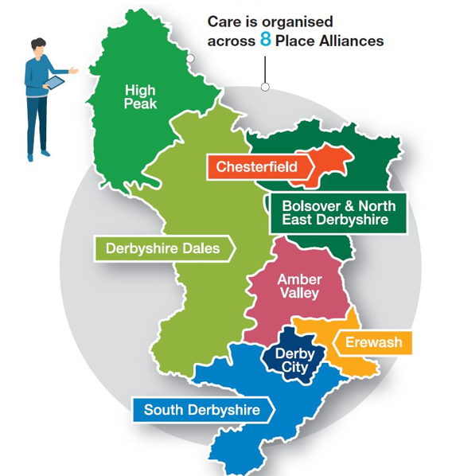
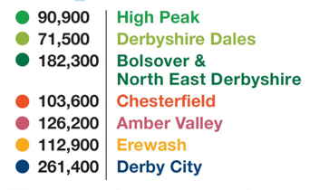
Notes:
Here is a map of the Place Alliances/neighbourhoods for visual reference with population size.

Slide 13
Primary Care Networks (PCNs)
What are PCNs?
Groups of GP practices working together to deliver care at a very local level.
PCNs support joined-up care, including mental health, social prescribing, and long-term condition management.
There are over 18 PCNs in Derbyshire, each serving around 30,000–50,000 people.
Benefits of PCN working:
Share resources, expertise, and services.
Bid for contracts to run services as a group.
Recruit and retain specialist staff to support GPs.
Improve integration with wider health and care system.
Enhance access to care close to home.
Broaden the range of services for patients.
Support sustainability of smaller practices.
Manage financial and estates pressures.
Reduce health inequalities.
Enhance health and wellbeing of the local population
Primary Care Networks
Notes:
PCNs receive funding directly from NHS England via Derby and Derbyshire ICB. Funding is provided through the Network Contract Directed Enhanced Services (DES), which sets out the national requirements and payments for PCNs.
The DES is a nationally agreed contract that provides additional funding and sets out requirements for GP Practices to work together in PCNs and offers extra funding for GP practices to deliver specific services beyond their core work.

Slide 14
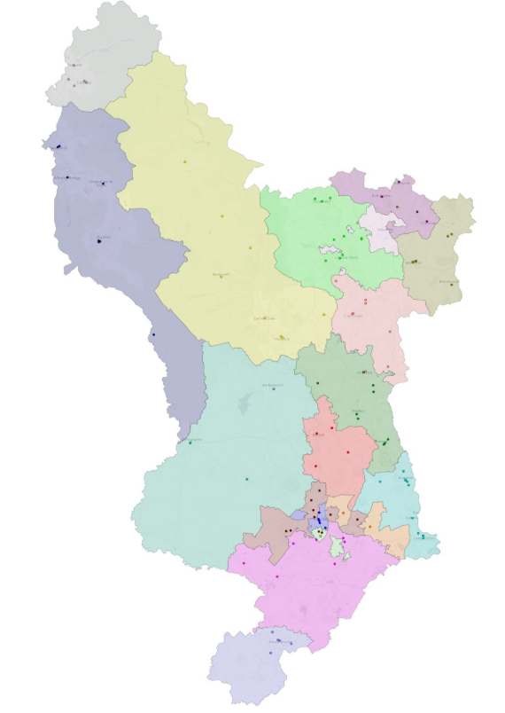
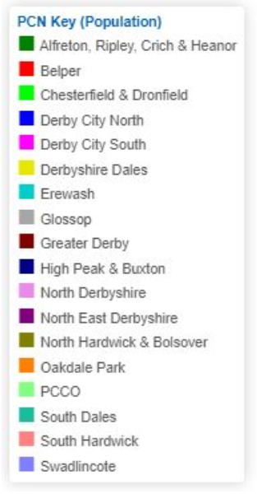
Notes:
These are all the PCN areas.

Slide 15
PCNs – NHS Reform
PCNs will remain central to delivering care at the neighbourhood level.
There will be:
Greater emphasis on integrated neighbourhood teams combining GPs, community services, mental health, and social care.
PCNs will work more closely with Place Partnerships to deliver prevention and personalised care.
Funding and priorities may shift toward population health management and reducing hospital demand.
PCNs are expected to be the delivery arm for many ICS strategies, especially in community-based care

Slide 16
Health and Wellbeing Boards
Health and Wellbeing Boards are formal committees in each local authority area.
They bring together NHS, local government, public health, social care (children’s and adults), local Healthwatch and the voluntary sector.
Purpose:
Improve health and wellbeing of local people.
Promote integration of health, care, and public health services.
Develop the Joint Strategic Needs Assessment (JSNA) and set local priorities.
Derby City Health and Wellbeing Board
Derbyshire Health and Wellbeing Board
Notes:
JSNA is a process where the local council and NHS work together to collect and analyse information about the health and well-being needs of people in Derby and in Derbyshire. The JSNs helps us to understand what our communities need now and in the future, so we can plan and improve health and care services and reduce inequalities.

Slide 17
Health and Wellbeing Boards – NHS Reform
HWBs may absorb some functions of Integrated Care Partnerships (ICPs) if ICP statutory status is removed.
They will play a bigger role in local accountability and democratic oversight.
We could expect closer alignment between HWBs and ICS governance to ensure integration with social care and public health

Slide 18
Provider Collaboratives
What is a Provider Collaborative?
A group of NHS providers working together to improve services across the region.
They share expertise, coordinate care, and reduce duplication.
In Derbyshire, collaboratives include acute hospitals, mental health services, and community care providers.
Provider collaboratives » Joined Up Care Derbyshire
Notes:
Provider collaboratives are NHS Providers working across acute, mental health, and community services.
Their aim is to reduce duplication, share expertise and improve coordination.

Slide 19
Local Authorities (LA’s)
What are LAs?
Lead agencies for social care, public health, and community wellbeing.
In Derby and Derbyshire, this includes Derby City Council and Derbyshire County Council.
They manage adult and children’s social care, housing, and public health initiatives.
Local authorities are key partners in the Integrated Care System (ICS), shaping place-based priorities and supporting population health
Notes:
LA’s lead on children’s and adults’ social care, housing, and public health.
We have Derby City Council and Derbyshire County Council.
They are key partners in shaping place-based priorities and supporting population health.

Slide 20
NHS Foundation Trusts
What are NHS Foundation Trusts?
Organisations delivering healthcare services across acute, community, and mental health settings.
NHS Trusts collaborate with other partners to ensure continuity of care and integrated service delivery
Notes:
NHS Foundation Trust deliver acute, community and mental health care.
They collaborate with each other and system partners to ensure continuity of care and integrated service delivery.

Slide 21
NHS Foundation Trusts – In Derby and Derbyshire
University Hospitals of Derby and Burton Foundation Trust
Royal Derby Hospital
Queen’s Hospital, Burton
Samuel Johnson Community Hospital, Lichfield
Sir Robert Peel Community Hospital, Tamworth
Florence Nightingale Community Hospital, Derby
Chesterfield Royal Hospital Foundation Trust
Chesterfield Royal Hospital
Derbyshire Community Health Services Foundation Trust
12 community hospitals, 4 Urgent Treatment Centres
Derbyshire Healthcare Foundation Trust
Mental health, learning disabilities and substance misuse services, plus children’s health services, and the East Midlands Gambling Harms Service.
Notes:
In Derby and Derbyshire, NHS Foundations Trusts include …

Slide 22
Voluntary, Community and Social Enterprise Alliance (VCSE)
What is the VCSE Alliance?
Voluntary, community, and social enterprise organisations supporting health and wellbeing.
Includes charities, faith-based groups, mutual support networks, and small volunteer-led organisations.
VCSE groups deliver tailored services, represent community voices, and support vulnerable populations.
In Derbyshire, VCSE organisations are strategic partners in the ICS and contribute to place partnerships and neighbourhood-level engagement
Notes:
The VCSE include charities, faith groups and small volunteer organisations.
They deliver tailored services, represent community voices and provide support to vulnerable groups.
They are strategic partners within the ICB and contribute to place partnerships and neighbourhood level engagement.
The VCSE Alliance is vital for connecting the NHS and local authorities with grassroots organisations. They help us reach and support communities who might otherwise be overlooked

Slide 23
Healthwatch Derby and Derbyshire
What is Healthwatch?
Healthwatch is the independent champion for people using health and social care services.
They listen to the experiences of people using services and gives them a stronger say in influenceing how local services are provided.
They use feedback to help NHS leaders and decision makers improve standards of care.
They provide information and advice to help people get the information and support they need.
They are part of a network of over 150 local healthwatch across England.
Notes:
Healthwatch is the independent champion for people who use health and social care services.
The main role of Healthwatch is to listen to the experiences of people using these services.
Healthwatch uses this feedback to help NHS leaders and decision makers improve standards of care.
Meaning that the real experiences of patients and service users help shape improvements.
Healthwatch also provides information and advice, helping people understand their options and get the support they need to access services.
There are over 150 local Healthwatch across England.

Slide 24
Healthwatch – NHS Reform
Healthwatch England and all local Healthwatch organisations are planned to be abolished as part of the NHS reform.
Healthwatch is expected to continue ‘business as usual’ until March 2027.
After abolition:
The NHS will take responsibility for patient voice and feedback on healthcare services.
The Department of Health and Social Care (DHSC) will oversee feedback for social care services.

Slide 25
NHS 111
What is NHS 111?
24/7 online and telephone for urgent medical support and signposting
Health and clinical advisors provide advice for self-care, referrals to medical professionals, booking urgent care appointments, and dispatching ambulances if necessary
National service – provided by community interest company DHU Healthcare through a regional contract for the Midlands
Notes:
NHS 111 is a 24/7 service for urgent medical advice.
It provides advice online and on the telephone.
In the midlands it is delivered by DHU Healthcare (based in Pride Park Derby)

Slide 26
Ambulance Services
Emergency service provided by East Midlands Ambulance Service NHS Trust
Non-emergency patient transport provided by EMED Group (from April 2025)
Notes:
For emergency services, in Derbyshire our ambulance services are provided by EMAS.
For non-emergency patient transport, as of April 2025, it is now provided by EMED Group.

Slide 27
Thank you
If you have any questions or would like to provide feedback on this document please email: ddicb.engagement@nhs.net

