Slide 1



Primary Care Quality Team Update
Lisa Roberts, ICB Clinical Quality Manger
Jessica Timmins, ICB Head of PC Nursing & Quality

Slide 2
Primary Care Quality Team
Update:
The latest GP National Patient Survey 2025 results – released 9th July (GP Patient Survey)
CQC Ratings – General Practice Position July 2025

Slide 3
General Practice National Patient Survey Results - 2025
The GP Patient Survey is a large, independent survey run annually by Ipsos on behalf of NHS England. It collects feedback from patients aged 16 and over about their experiences with GP practice services across England. The survey covers topics such as:
Access to GP practices
Making appointments
Quality of care received
Experiences when the practice is closed
Use of NHS pharmacy and dental services
Support for long-term conditions or disabilities

Slide 4









Summary
DERBY AND DERBYSHIRE INTEGRATED CARE SYSTEM
QUESTIONNAIRES SENT OUT
37,468
76%
68%
NUMBER OF COMPLETED SURVEYS
12,689
had a good overall experience of their GP practice
had a good overall experience of contacting their GP practice
RESPONSE RATE
34%
Q32 National result: 75%
Q16 National result: 70%
Base: ICS 12,634; National 699,562
Base: ICS 12,412; National 686,100
61%
88%
72%
had a good overall experience of NHS services when their GP practice was closed
had a good overall experience of pharmacy services
had a good overall experience of NHS dental services
Q36 National result: 57%
Q48 National result: 88%
Q52 National result: 71%
Base: ICS 3,397; National 193,580
Base: ICS 11,582; National 631,337
Base: ICS 7,128; National 368,026

Slide 5





Summary
DERBY AND DERBYSHIRE INTEGRATED CARE SYSTEM
QUESTIONNAIRES SENT OUT
37,468
93%
92%
NUMBER OF COMPLETED SURVEYS
12,689
had confidence and trust in the healthcare professional they saw or spoke to
were involved as much as they wanted to be in decisions about their care and treatment
RESPONSE RATE
34%
Q28 National result: 93%
Q29 National result: 91%
Base: ICS 12,107; National 665,885
Base: ICS 11,555; National 635,043
82%
91%
69%
of patients who managed to contact their practice knew what the next step would be in dealing with their request
felt that their needs were met during their last appointment
felt they had enough support from local services or organisations to help them manage their conditions or illnesses
Q12 National result: 83%
Q31 National result: 90%
Q43 National result: 69%
Base: ICS 11,853; National 654,818
Base: ICS 12,143; National 666,889
Base: ICS 6,393; National 337,532

Slide 6
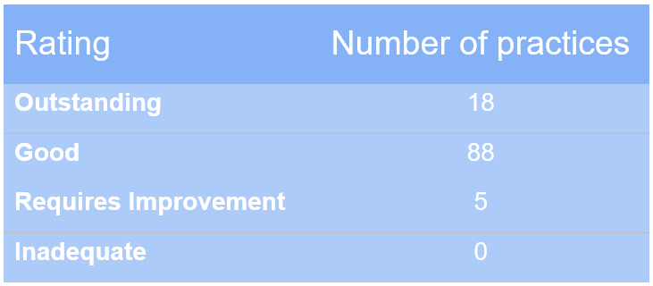
CQC Update:
  Summary of CQC ratings for Derby and Derbyshire Practices as of the 14th July 2025
Rating
Number of practices *
Outstanding
18
Good
88
Requires Improvement
5
Inadequate
0

