Slide 1



Primary & Secondary Care Interface
PPG Event
July 2025

Slide 2
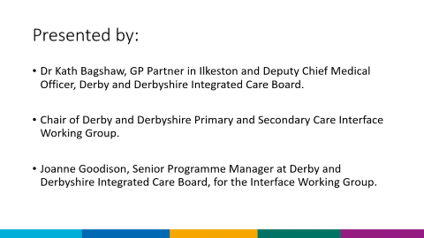
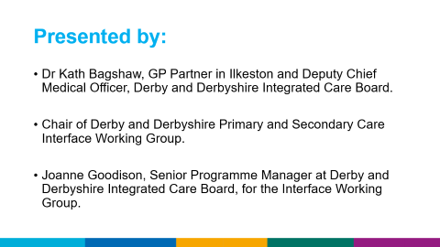
Presented by:
Dr Kath Bagshaw, GP Partner in Ilkeston and Deputy Chief Medical Officer, Derby and Derbyshire Integrated Care Board.
Chair of Derby and Derbyshire Primary and Secondary Care Interface Working Group.
Joanne Goodison, Senior Programme Manager at Derby and Derbyshire Integrated Care Board, for the Interface Working Group.

Slide 3
Red Tape Challenge
NHSE-led by Clare Fuller, GP and Primary Care Medical Director for NHS England.
Engaged wide range of stakeholders, in collaboration with NHS Confederation:
Phase One – Listening (until mid-December 2024)
Phase Two – Testing emerging recommendations (December/January 2025)

Slide 4
Red Tape Challenge
Multi-faceted approach of:
surveys (1500+ responses)
case studies (c.200 emails)
presenting to existing forums and bespoke sessions
underpinned by a literature review of previous interventions
Feedback from 7 PCN Test Sites:
15-20% of workload could be done elsewhere in the NHS/other providers, avoiding duplication, improving efficiency and patient experience.

Slide 5
Red Tape Challenge
Enabler-focused working groups - collating ‘examples of best practices’ in general practice through a rapid review with a focus on the following areas:
Medicines & Prescribing
Data, Digital and Technology
Workforce, Training and Education
Contractual and Financial Flows
Metrics
Estates

Slide 6
Red Tape Challenge
Reducing unnecessary bureaucracy and administrative burdens to improve patient care and free up clinicians’ and NHS staff time.
Publication of NHS 10 Year Plan July 2025, and expectation that Red Tape Challenge will be published following this.
There will be longer strategic approaches as well which will be built into the NHS 10-year plan.
Both these publications will drive the future strategic aims and objectives of the work within the Primary and Secondary Care Interface.

Slide 7
Red Tape Challenge-For Patients
By improving how Primary & Secondary Care work together, this will mean patients move more smoothly between the primary and secondary care interface, ensuring:
Better communication between clinical and administrative staff
Quicker progression for a patient’s journey, including clinical management, appropriate referrals and access to appropriate investigations
Less confusion for patients
More efficient use of NHS resources

Slide 8
Red Tape Challenge: Derbyshire
  A Primary & Secondary Care Interface Group was established in April 2024 bringing together Chief Medical Officers from all Derby and Derbyshire NHS Trusts.
    University Hospitals of Derby & Burton
    Chesterfield Royal Hospital
    Derbyshire Community Health Services
    Derbyshire Healthcare Foundation Trust
    GP Provider Board, Derby & Derbyshire Local Medical Committee, Provider Collaborative Leadership Board and the Integrated Care Board.
  The group provides leadership in how care can be improved through better primary and secondary care interface processes and behaviours.

Slide 9
Red Tape Challenge
The national delivery plan for 2024/25 asked ICBs to focus on and report their progress against four main recommendations on how to improve the interface from the Academy of Medical Royal Colleges report, including:
  Onward referrals.
  Complete care (fit notes and discharge letters).
  Call and recall.
  A single point of contact for clinicians - all Trusts are now live with these. Direct Patient Care queries from GP practices.

Slide 10
Advice & Guidance (A&G)
A&G is a digital communication pathway that allows clinicians, typically GPs, to seek expert advice from specialists before or instead of formally referring a patient for specialist care.
Inclusion of the A&G Direct Enhanced Service contract for General Practice for 2025/26.
A&G leads to quicker access to specialist advice and clinical management, improved patient care and reduced unnecessary hospital visits. In the longer term the NHSE ambition is that this will reduce waiting times for outpatient appointments.
The Primary & Secondary Care Interface Working Group will lead on oversight of the quality improvement of A&G, which will lead to further improvements in patient care across Derby & Derbyshire.

Slide 11
Patient Experience
Keen to gather patient insights linked to Interface related issues.
To help to develop prioritisation for areas of focus.
NHSE Guidance on focussed areas:
Onward referrals
Fit Notes & Discharge Letters
Call & Recall
Clear Points of Contact
Already accessed existing forums to capture Interface related issues raised by patients; including consultation forums, Healthwatch, Patient and Carer consultations, PPG groups and provider patient complaint platforms.

Slide 12
Patient Experience linked to the Interface raised by patients through various routes
GP practice attempts to contact the Community and Secondary Care teams, difficulty establishing a clear point of contact
Inconsistent communication re prescription changes
Delays to communication following outpatients or hospital discharge
Uncoordinated support following discharge, too early discharge, and poor discharge planning
Onward Referrals
Lack of sufficient referral management system-patients unclear how to access support
Re-referral from GP into secondary care

Slide 13
Contact Details
Name: Dr Kath Bagshaw
Title: Deputy Chief Medical Officer
Email: ddicb.primarycarequalityteam@nhs.net
Web: https://joinedupcarederbyshire.co.uk

